Slide 1
Predicting protein stability changes from sequences using support vector machines
Emidio Capriotti, Piero Fariselli,
Remo Calabrese and Rita Casadio*
BIOINFORMATICS, Vol. 21, Suppl.2 2005 ,Pages 54–58, 2001
Presenter: Jun-Xiong Lin
Date:2006.1.13

Slide 2
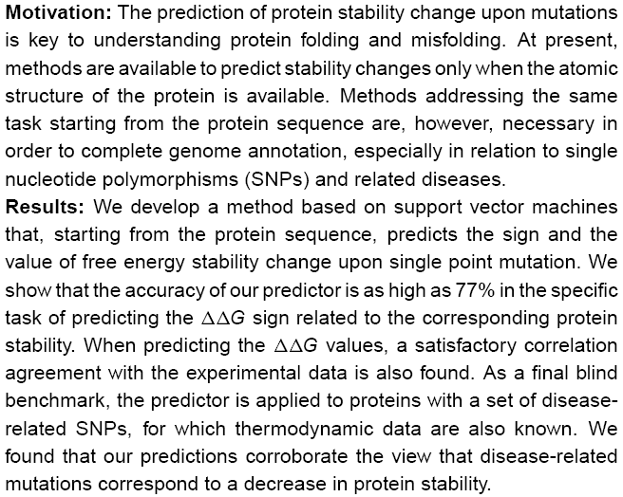
Abstract

Slide 3
Introduction
The stability changes upon protein mutation (ΔΔG value)
positive(+) : increase of stability.
negative(-) : decrease of stability.
The sign of ΔΔG
-
The ΔΔG sign
+

Slide 4
Introduction
A method based on support vector machines (SVMs) that predicts protein stability changes due to single point mutation starting from the sequence.
Owing to the availability of a large database of thermodynamic data for mutated proteins (Bava et al.,2004) we are able to show that for the specific task of predicting the ΔΔG sign.

Slide 5
Methods
The protein database:
The thermodynamic Database for proteins and Mutants (ProTerm by Bava et al., 2004).
Database constraints:
1. the ΔΔG value has been experimentally detected and is reported in the database.
2. the data are relative to single mutations (no multiple mutations have been taken into account).

Slide 6
Methods
The predictor:
(1)the prediction of the sign of the protein stability change upon single point mutation.
(2)the prediction of the ΔΔG value.
Machine learning algorithms:
an support vector machine with several kernels.

Slide 7
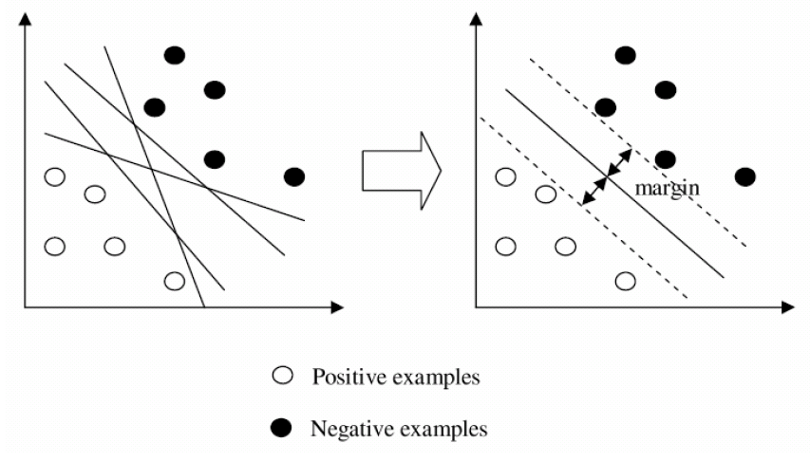
Support Vector Machines
A set of training data for binary class problem:
(x1, y1),…,(xN,yN) where xi ∈R ^{n} is the feature vector of the i th sample in the training data and yi ∈{ +1,-1} is its label.
Support vector

Slide 8
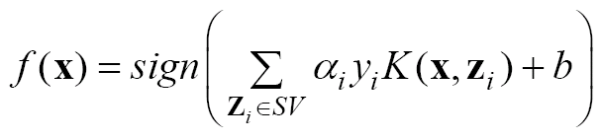
Support Vector Machines
Decision function :
x is a positive number, if f(x)=+1
x is a negative number, if f(x)=-1
Kernel function: K( x , z)
Input vector
Support vector

Slide 9
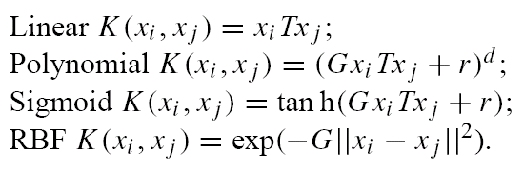
Support Vector Machines
Use LIBSVM.
Test the following available kernels:

Slide 10
Support Vector Machines
The increased protein stability(ΔΔG ≥ 0,desired output set to 1) or the decreased protein stability (ΔΔG<0,desired output set to 0) .The decision threshold is set equal to 0.5.

Slide 11
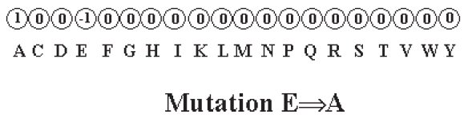
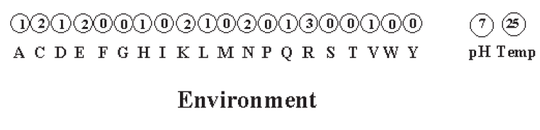
Support Vector Machines
The input vectors consist of 42 values.

Slide 12
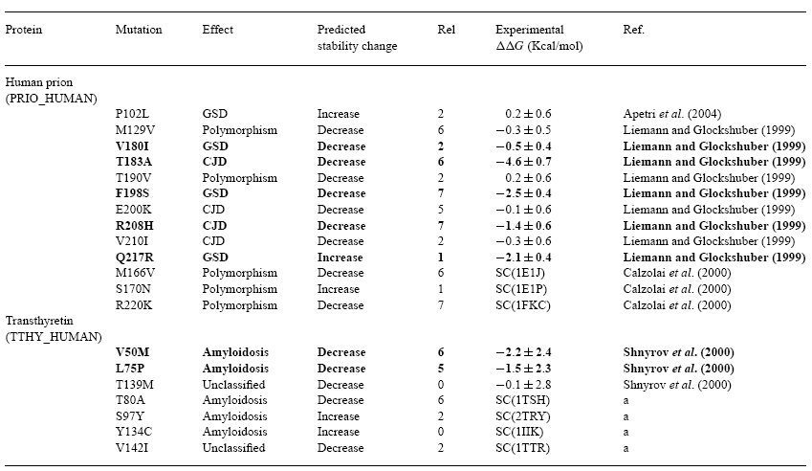
Prediction of disease-related mutations

Slide 13
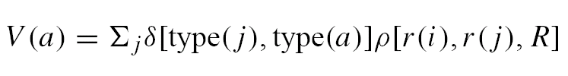
Support Vector Machines
The sequence residue environment:
a residue in the sequence position i of coordinate r(i) ,the element a
of the input vector V (of 20 components) is computed as
where j spans the protein length; δ[type(j ), type(a)] is set
equal to 1 only when the residue in position j is equal to
type a; ρ[r(i), r(j),R] is also set to 1 only if the Euclidean
distance between r(i) and r(j) is lower than the threshold R
(the sphere radius).

